Slide 1
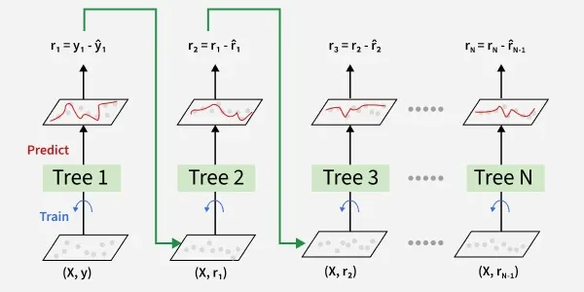
Gradient Boosting Foundations
Learning from Mistakes to Achieve Perfection
Instructor: Zaryab Ahmad Khan

Slide 2
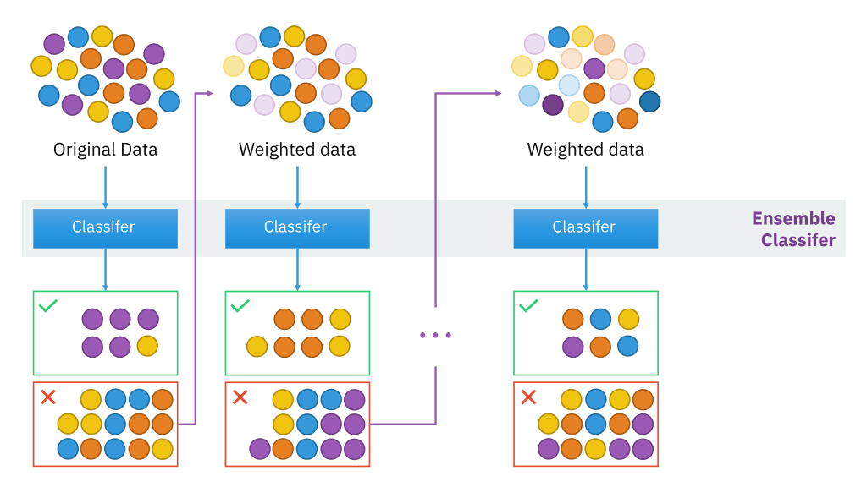
The Concept of Boosting
Sequential Learning: Unlike Random Forest (where trees are built simultaneously), Boosting builds models one after another.
The Logic: Each new model specifically tries to fix the mistakes made by the previous model.
Analogy: It is like a student who takes a quiz, sees which questions they got wrong, and spends 100% of their time studying only those wrong answers for the next quiz.

Slide 3
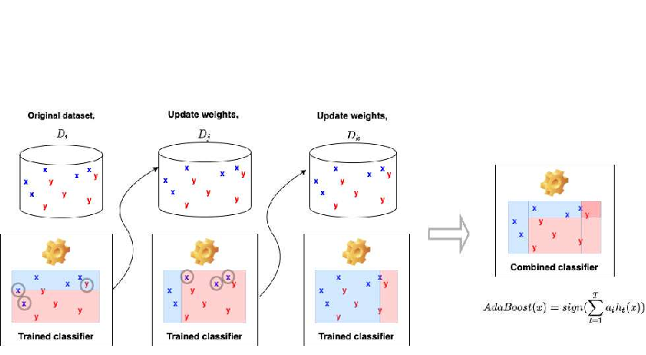
AdaBoost (Adaptive Boosting)
Definition: The classic boosting algorithm, widely used for basic classification tasks.
How it Works: It gives more "weight" to the data points that were misclassified by the previous model, forcing the next model to focus on the hardest cases.

Slide 4
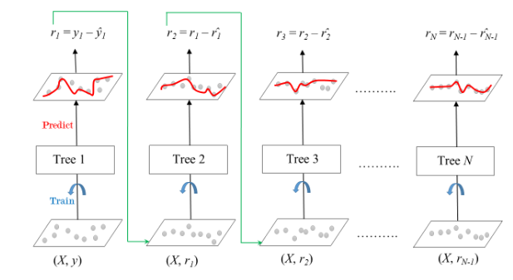
Gradient Boosting Regressor/Classifier
Definition: A more advanced version of boosting that uses calculus (gradients) to minimize errors.
The Power: It provides highly accurate predictions for standard tabular data (Excel-style data).
Efficiency: It is the "gold standard" for winning many machine learning competitions because of its extreme accuracy

